Slide 1
Dealing with Missing Values

Slide 2
Missing Values
Missing values: no data value is available for a variable in an observation

Slide 3
Newspaper Sales Data
Date | Sales
03/21/16 | 48
03/22/16 | 47
03/23/16 | 36
03/24/16 | 32
03/25/16 | 25
03/26/16 | 33
03/27/16 | 0
03/28/16 | 50
03/29/16 | 49
03/30/16 | 30
03/31/16 | 29
04/01/16 | 32
04/02/16 | 33
04/03/16 | 40

Slide 4
Newspaper Sales Data
Date | Sales | Column 3 | Column 4 | Column 5 | Column 6
03/21/16 | 48 | xxx | xxx |  | xxx
03/22/16 | 47 | xxx | xxx | xxx | xxx
03/23/16 | 36 |  | xxx | xxx | xxx
03/24/16 | 32 |  | xxx | xxx | xxx
03/25/16 | 25 | xxx | xxx | xxx | xxx
03/26/16 | 33 | xxx |  | xxx | xxx
03/27/16 |  | xxx | xxx | xxx
03/28/16 | 50 | xxx | xxx | xxx | xxx
03/29/16 | 49 | xxx | xxx |  | xxx
03/30/16 | 30 | xxx | xxx | xxx | xxx
03/31/16 | 29 | xxx | xxx | xxx
04/01/16 | 32 | xxx | xxx | xxx | xxx
04/02/16 | 33 | xxx | xxx | xxx | xxx
04/03/16 | 40 | xxx | xxx | xxx | xxx

Slide 5

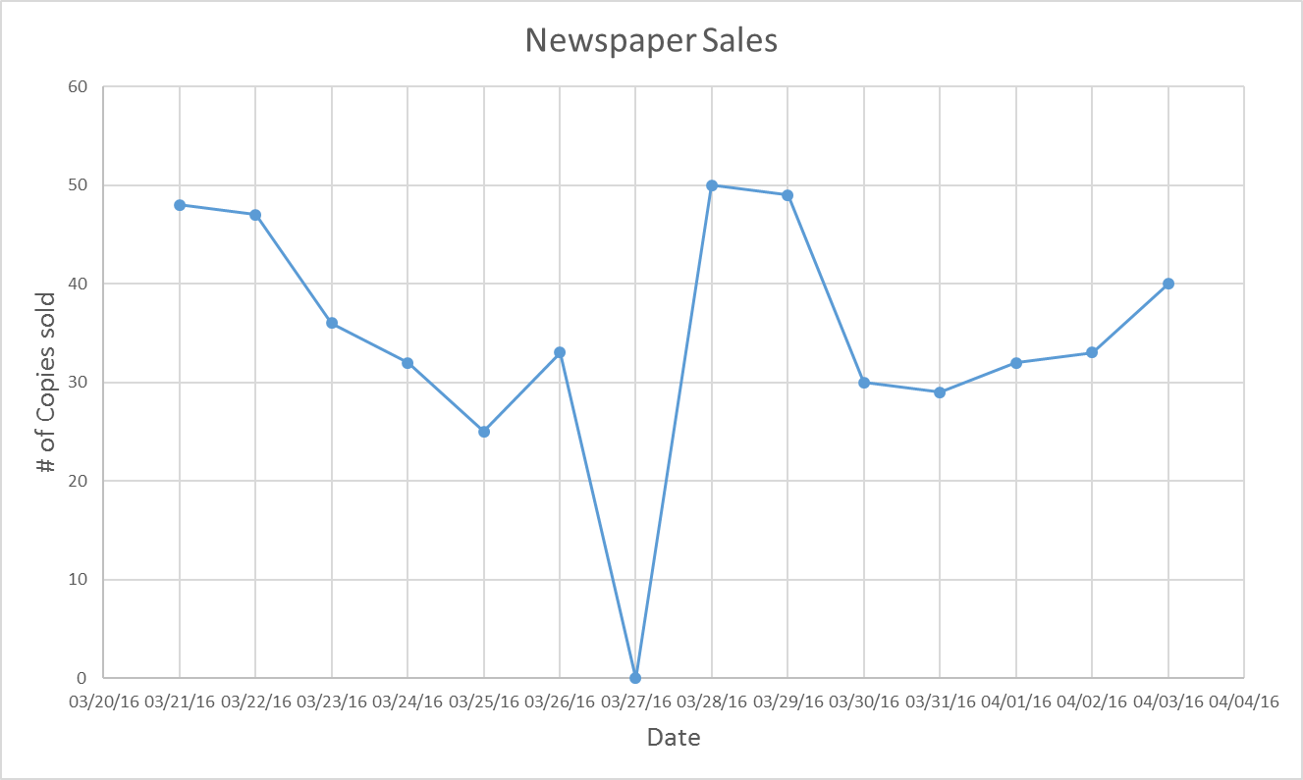
Line Plot of the Data

Slide 6
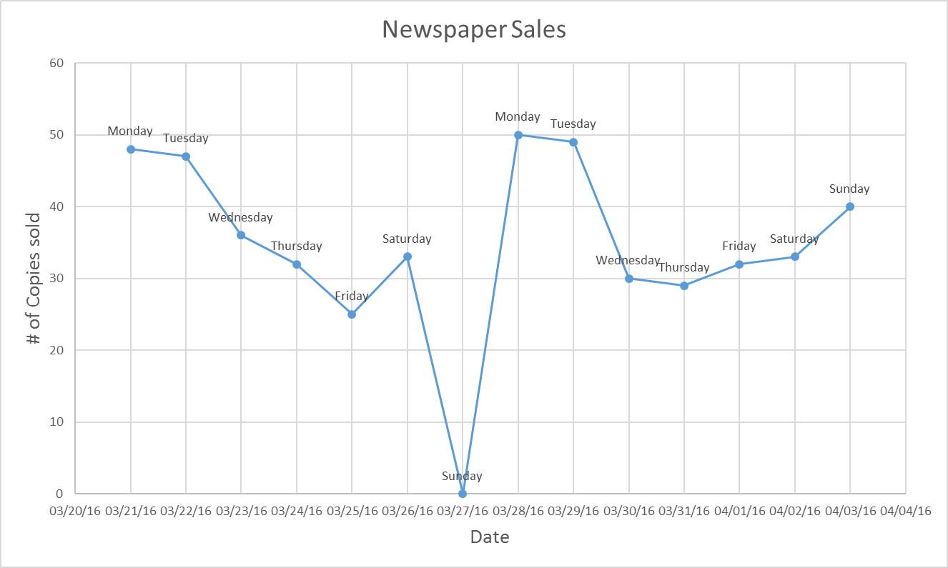
Line Plot with Weekday Information

Slide 7
Line Plot with Weekday Information
Easter Sunday

Slide 8
What to do about it?
Remove the corresponding row/column
Impute (“estimate”) a value
With zero
With average
With similar data points (“interpolation”)
Make “missing” its own category

Slide 9
Imputing a sales value for March 27
Date | Sales
03/21/16 | 48
03/22/16 | 47
03/23/16 | 36
03/24/16 | 32
03/25/16 | 25
03/26/16 | 33
03/27/16 | 0
03/28/16 | 50
03/29/16 | 49
03/30/16 | 30
03/31/16 | 29
04/01/16 | 32
04/02/16 | 33
04/03/16 | 40
Impute (“estimate”) a value
With zero
With average → 37.23
With similar data points
Using sales on Sunday, April 3 as an estimate → 40

Slide 10
Missing Values vs. Censored Values
Only 50 copies are available for sale each day.
The sales on Monday, March 28th is 50.
Sales data on that day is “censored.”

Slide 11
Missing Data Solutions
No single accepted solution.
Consider context.
Try not to induce biases or distortions.
Need enough data to remain for meaningful analysis.
Pattern of missing values can itself carry information.

